Slide 1
Real Estate App
BY XJM

Slide 2
Purpose
The purpose of this real estate app is to make it easier for a user to view different properties as well as be able view the images of the properties for sale.

Slide 3
Future implementations
Images of the properties
Crime rates scale of the area of the properties (low,medium,high)
More appealing User Interfaces(Home Page, Registration Page, Login Page)

Slide 4
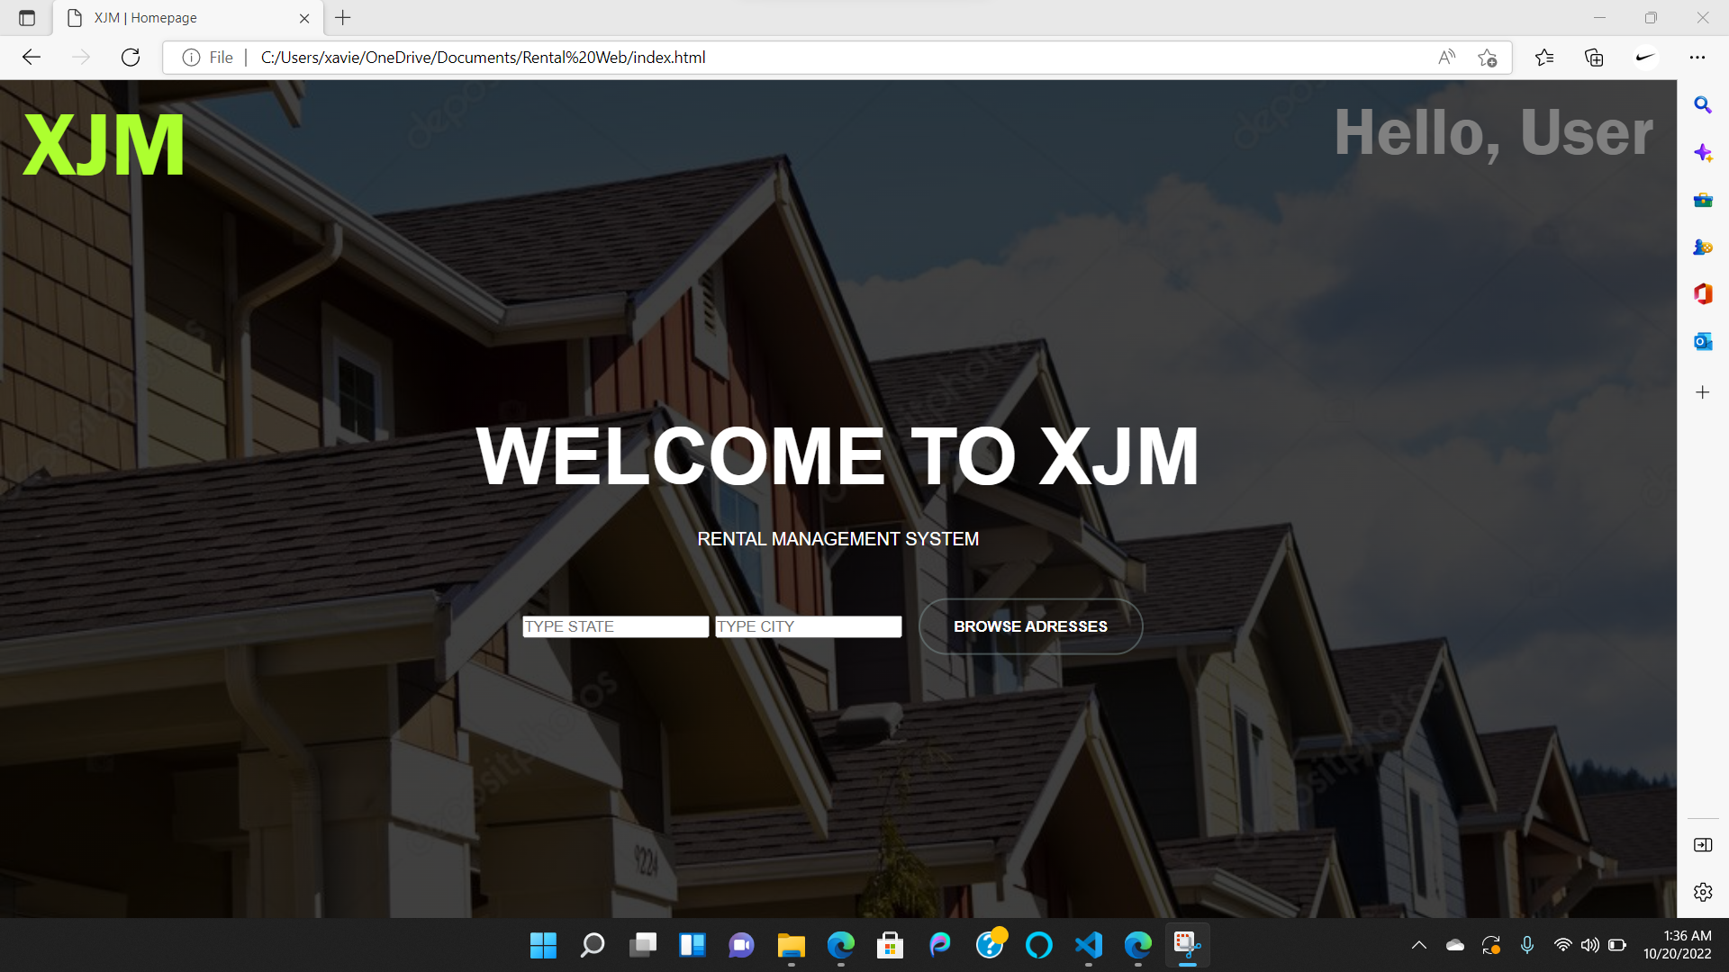
Home Page

Slide 5
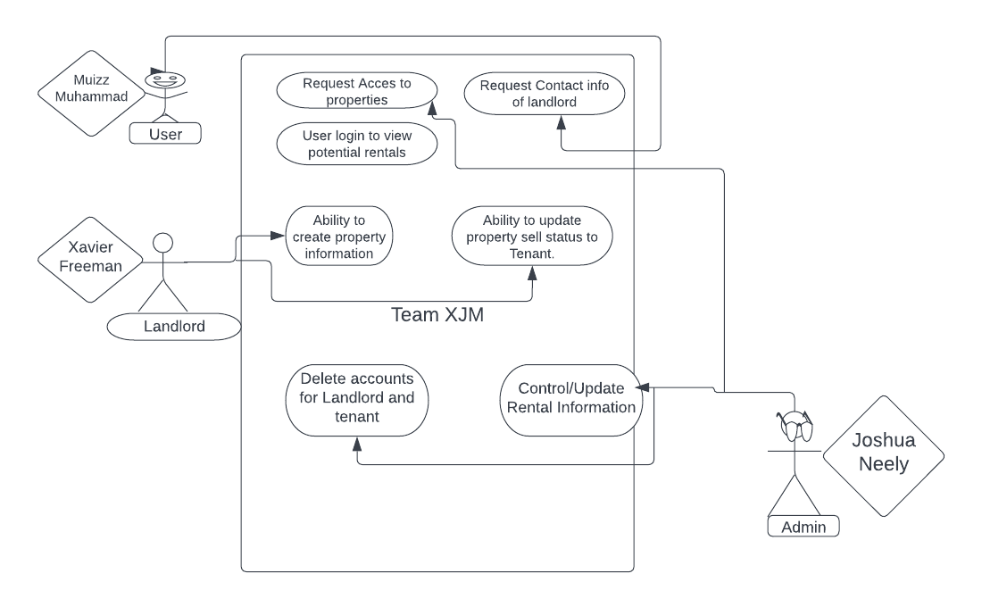
Use-Case Model

Slide 6
User
Browse houses to rent on a web app
Make an application to the landlord to rent a house

Slide 7
Landlord
Ability to create property information.
Ability to update property sell status to Tenant.

Slide 8
Administrator
Ability to remove profiles.
Ability to update the house information as needed.

